Slide 1

Supermarket billing system
Group Id.: 07
Presented by : Guided By :
Rajvi Panchal (30) Prof. Devendra Thakor
Aarzin Todiwala (43) C.E./I.T. Dept.
7th Sem. B. Tech. (C.E.) C.G.P.I.T.
C.G.P.I.T.

Slide 2
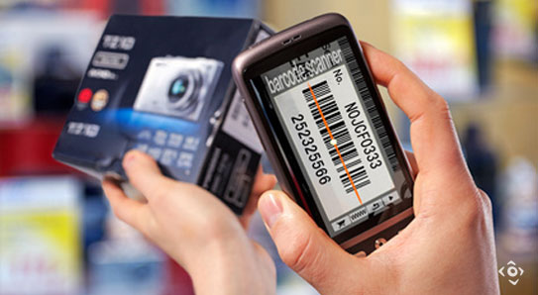
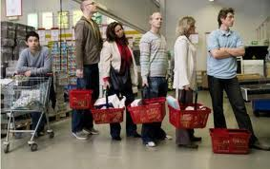
1. Definition
“Supermarket billing system” is a project with an aim to solve the problem of time-consuming billing system in supermarkets.
The main goal is to SAVE TIME.
It bill's your items in parallel with shopping.
The application reduces much of human efforts in calculating bill especially for huge number of products.

Slide 3
2.Objective
The traditional supermarket billing system is time-consuming and tedious.
People have to stand in long queues to generate bills.
An overcrowded counter is always annoying.
This application guarantees customer satisfaction by saving time and energy.
That means you don’t have to stand in line and wait to pay.

Slide 4
3. Application
Can be implemented to any supermarket which wants to automate bill generation process to make it faster & more user-friendly.

Slide 5
4. Scope of project
This application is supermarket-specific but with few modifications it can be implemented by every other supermarket/mall. Every supermarket has their own server and database schemas. Hence, with little modification, the application can be used by any supermarket.We can start implementation of the project with small firms and expand it to be implemented in large malls and super markets. The supermarkets can have the application registered with their name. Since it requires basic knowledge about android phone, it can be used by the elderly too.

Slide 6
4. Timeline chart
2016
Day 1
13
26
39
52
65
78
91
104
117
130
2016
Today(136)
Decide project area
7/18/2016 - 7/24/2016
Decide group members
7/25/2016 - 7/31/2016
Decide project definition
8/1/2016 - 8/7/2016
Requirement gathering
8/8/2016 - 8/15/2016
Generate SRS
8/13/2016 - 8/23/2016
1st presentation
8/16/2016
Coding
8/24/2016 - 10/01/2016
2nd presentation
9/24/2016
Testing
10/28/2016 - 11/11/2016
10/28/2016 - 11/22/2016
Implementation
6
Maintainence
10/17/2016 - 11/05/2016
Final presentation
12/02/2016

Slide 7
5. Environmental Characteristics
Hardware Requirements: A Smart-Phone for the installation of application with good camera.
Software Requirements: Smart phone with android OS.

Slide 8
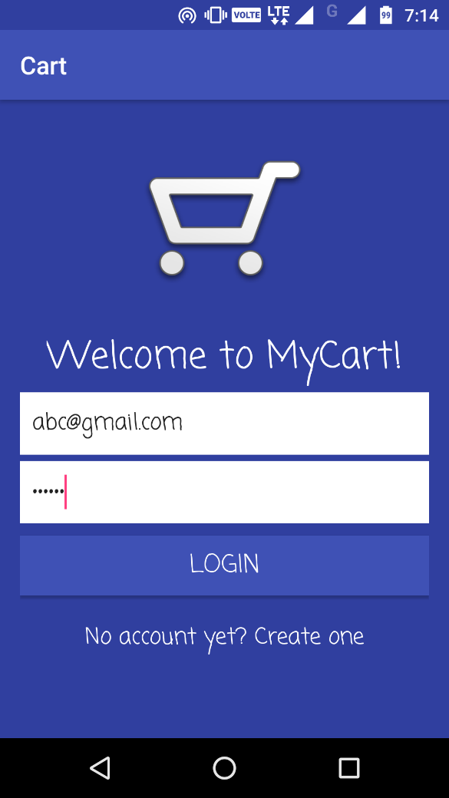
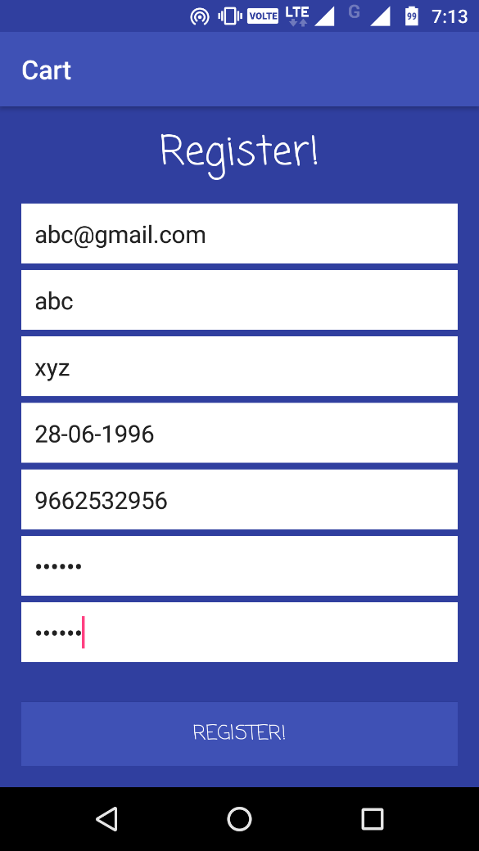
6. Modules
Login Module
Registration module

Slide 9
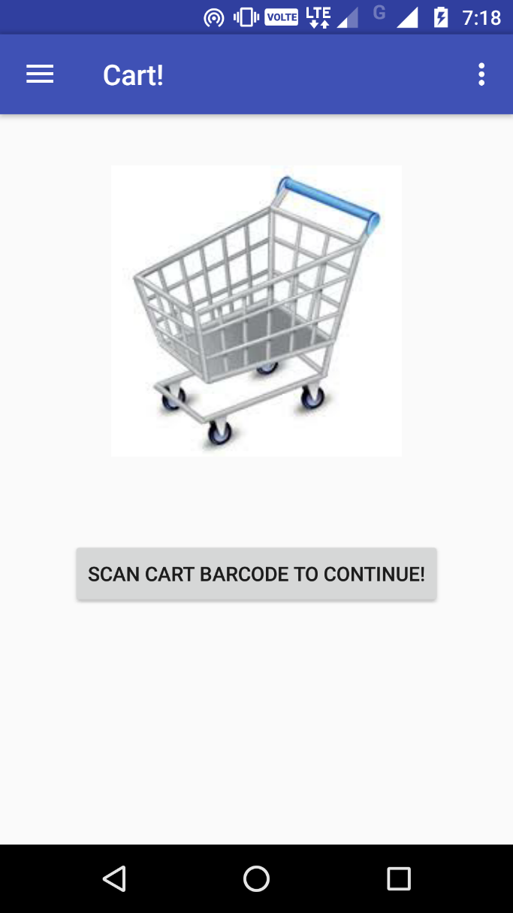
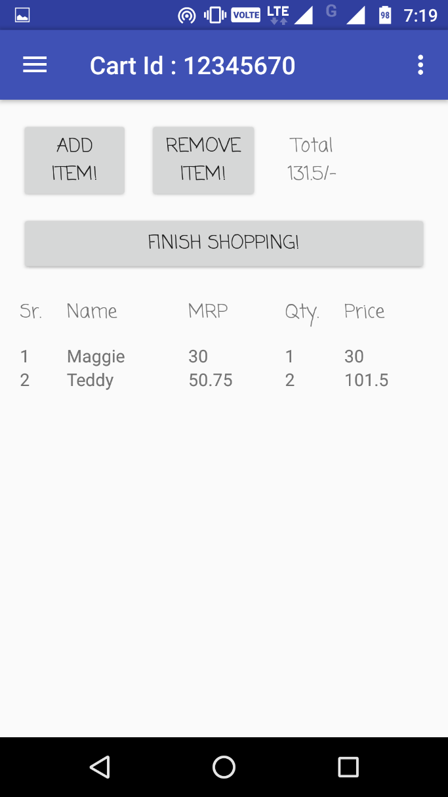
Scan Item

Slide 10
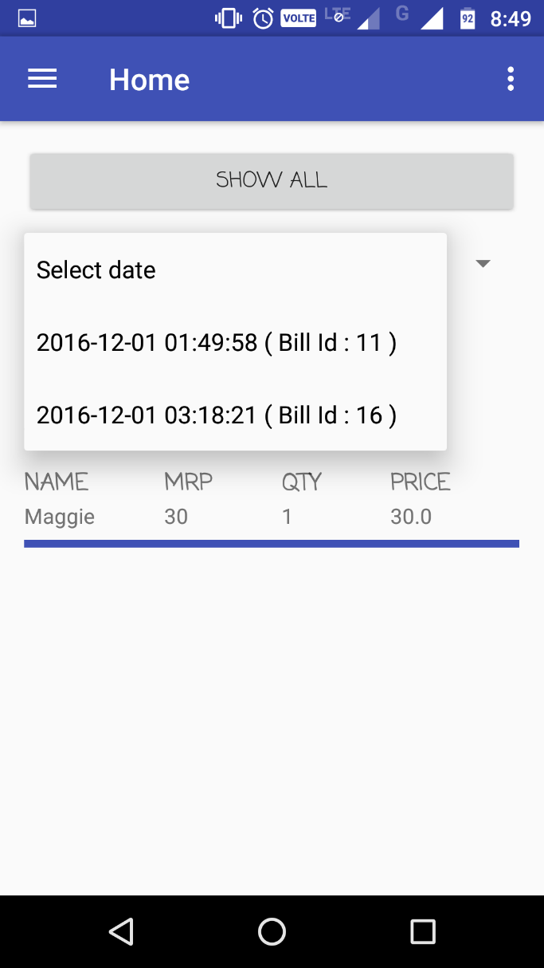
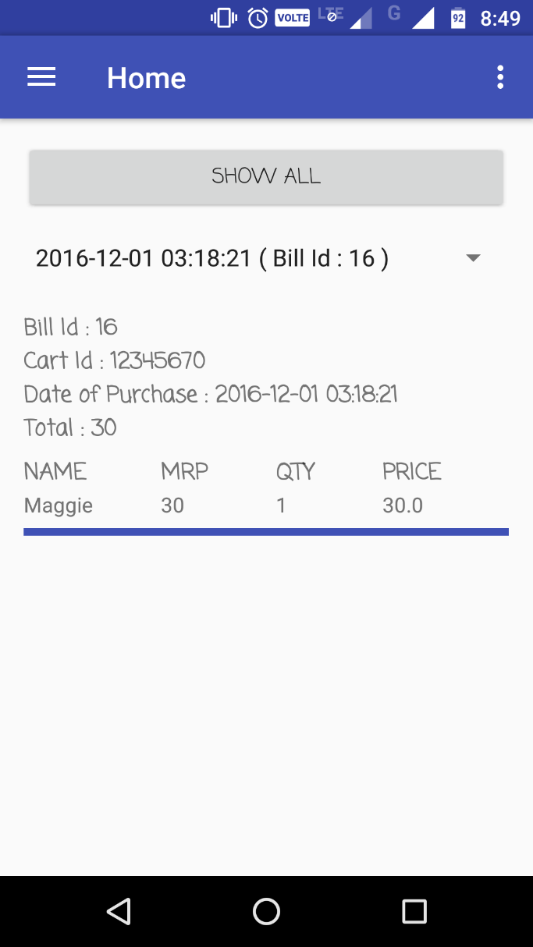
View History

Slide 11
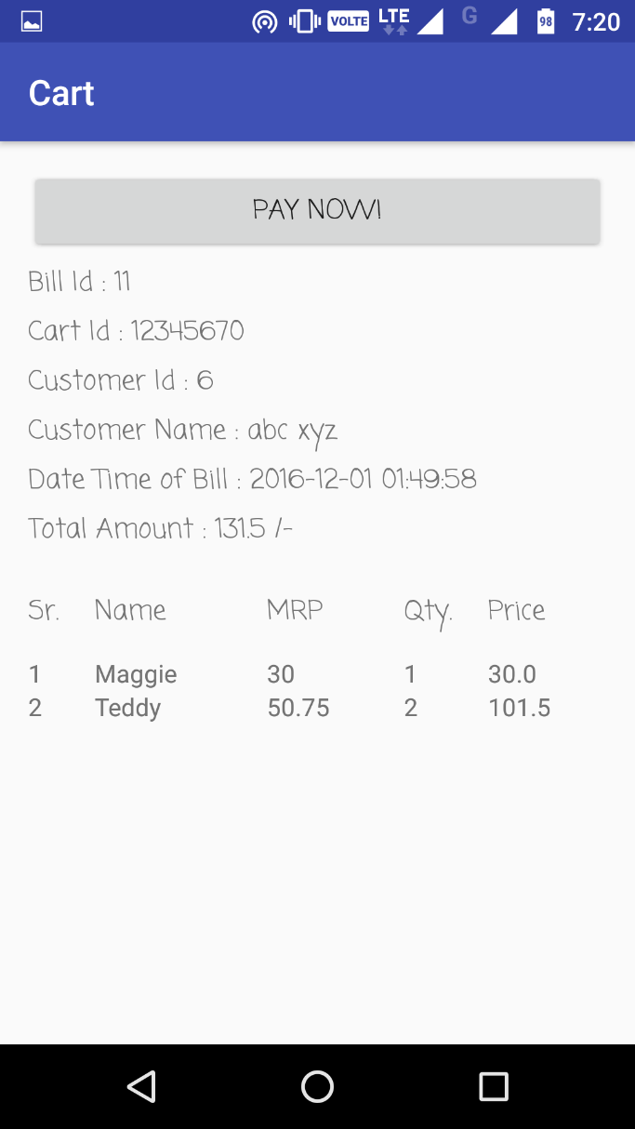
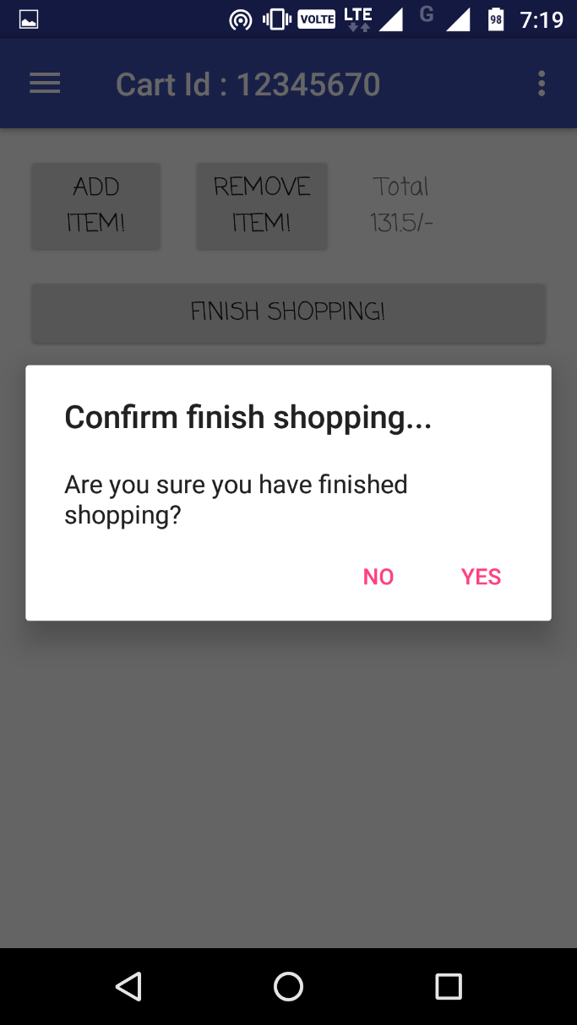
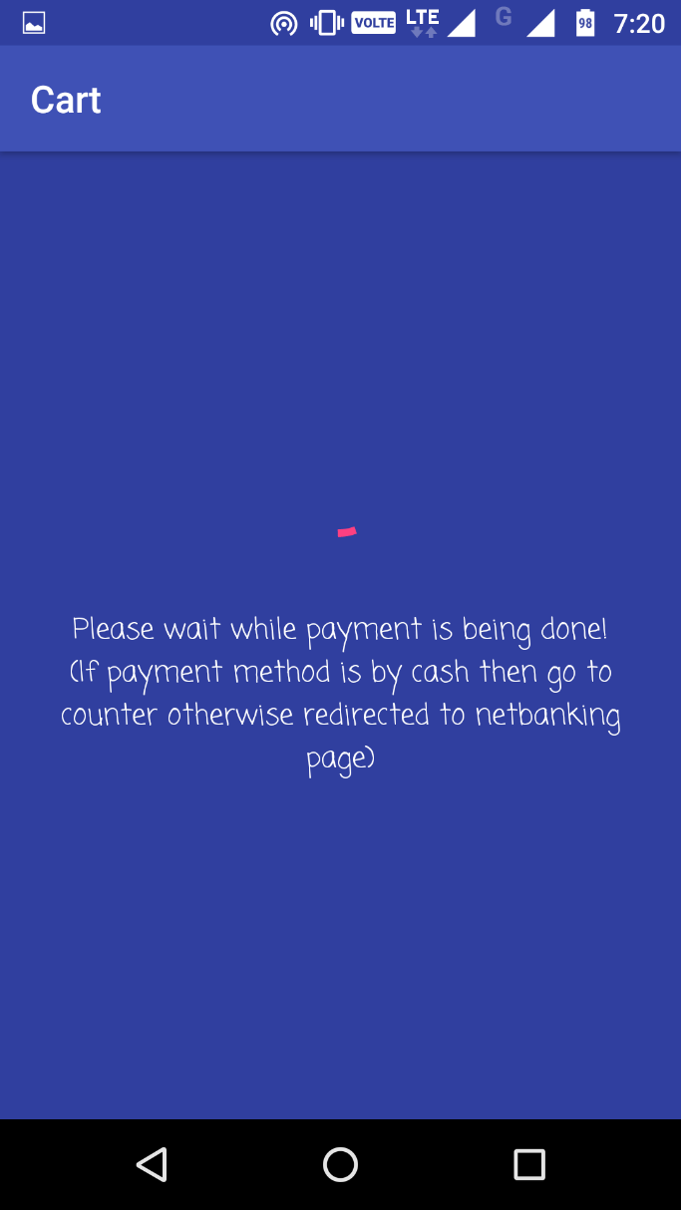
Bill Generation

Slide 12
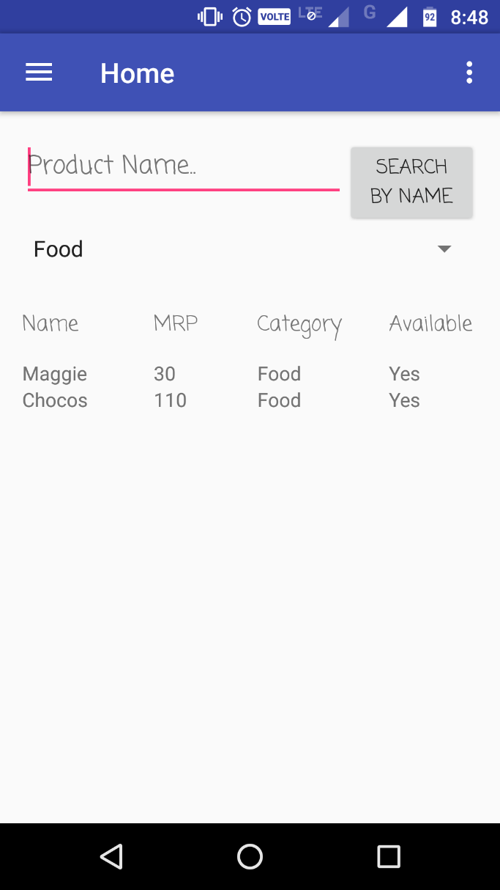
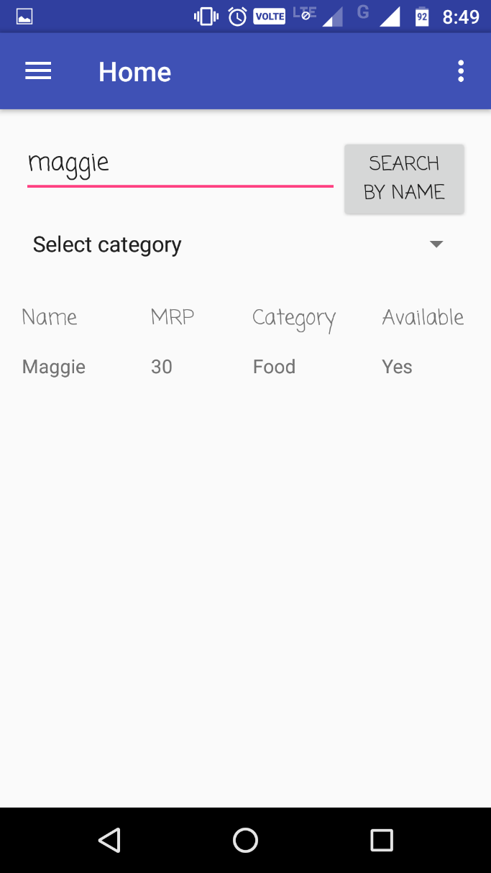
Search Product

Slide 13
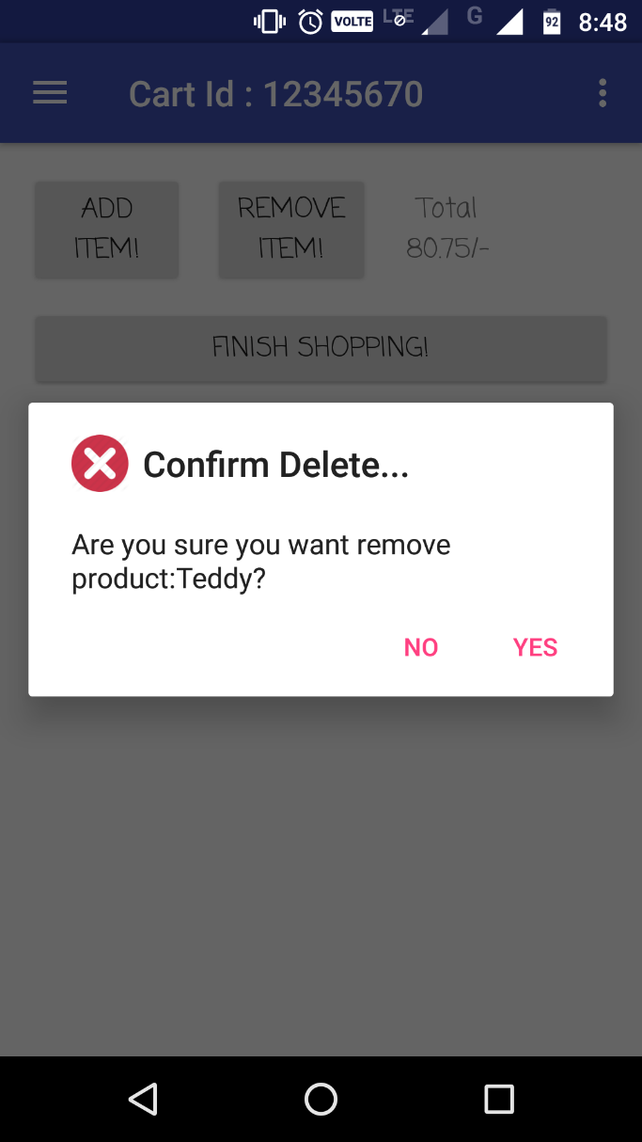
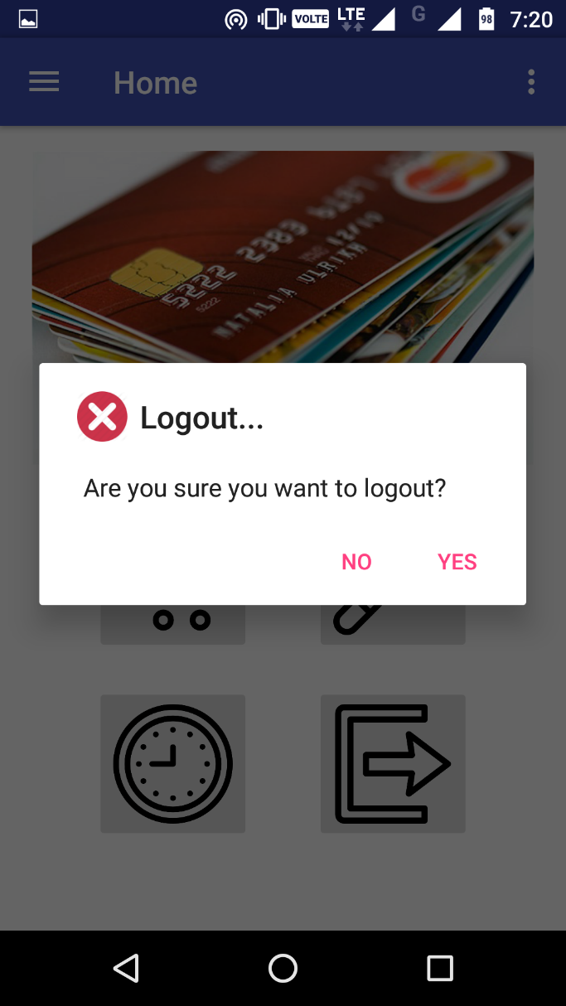
Delete Item
Logout

Slide 14
Conclusion:
The inspiration and idea of this application was drawn from large queues at the shopping mall and the inconvenience that it causes to the costumers. This new system of billing is fast as the bill is generated along with shopping as the product is scanned and is dropped into the cart. Moreover, this smart application will be very beneficial as it would reduce the number of salesmen and billing counters and also prove to be time saver for both customer and the shopkeeper.

Slide 15
Future Scope
There are some more features to be added such as: Application applicable for multiple supermarket and further more bug fixes if necessary.

Slide 16
Thank you!!

